Slide 1
Managing our Home Technology “How to stay busy during a virus”
Discussion Topics
Desktop PC remodel
Internet component refresh
Home Wi-Fi Assessment
Influence of “smart tv” – how to be ready!
Importance of understanding your Invisible Asset

Slide 2
Home Communication Support – 2021 +
Key Topics
The Past – Present – Future of Connecting
Desktop PC migration to
Tablets (Ipads / Androids)
Phones (simple to smart – Iphone)
TV’s (simple to smart – 32” Std to + 65”)
Streaming services / Blue Tooth connections
Adding apps
Requires strong wireless connection support

Slide 3
Upgrade Strategy!
Hope for the best or learn how to replace!
Replace / Upgrade / Learn / Adjust / Research
Upgrade Desktop Monitor (21 to 24”)
Evaluate Desktop Unit (HD/Chip/Graphics Cd/Memory)
Replace Modem / Router (Altice)
Extender vs Mesh (what’s the difference?)
Smart TV (PC club)
Value of Speedtest (PC club)
Identifies the invisible communication issue
Where is the poor signal / what device is impacted?
Impact of Covid19 > Zoom / Facetime

Slide 4
What is our invisible problem?
Your home Wi-Fi signal!
Supports & enhances our satisfaction with all aspects of communication activity
Grows in importance each year
What can I do to learn how to evaluate
Solution: SPEEDTEST APP

Slide 5
Wi-Fi Communications Plan & Support
The Past
2021 > Future
Desktop PC
Iphone
Smart TV
Zoom / Facetime
Monitor
Ipad
Streaming
Netflex
Disney +
YouTube
Hulu
Firestick (Amazon)
Apple TV
Modem/Router
LapTop

Slide 6
My Wi-Fi Problem
TV
Upstairs –Bedrooms
Wi-Fi Need / Devices
Family Room
Bed Room
Mesh Node
Kitchen
Extender
Office
Facetime
Desktop PC
Router / Modem
Living Room
Dining Room
Basement
Wi-Fi Need / PC - TV

Slide 7
Desktop PC Remodel
Brand = Acer / Installed Dec. 2012 (8 yrs)
Components evaluated / changed
Monitor (upgrade from 21” to 24” / Dell $ 258 May )
Eliminated desk speakers/ major quality gain
Hard drive assessment (PCMac Technology)
Installed Nexigo 1080 FHD Webcam (Zoom need)
60 fps (excellent pic quality) / wide-angle ($ 63)
(Issue: Unable to create background when on Zoom call / research solution)

Slide 8
Internet / Wi-fi refresh
Starting point - original modem / router (+ 7 Yrs)
Provider: Optimum (Altice)
Visit to Oakland & replaced Modem & Router
Determined Wi-Fi signal poor in most area’s
200 mps monthly plan
Replaced router (Nov.2020)
TP-Link 1750 ($66) & Netgear Extender ($54)
Dec. – extensive “speed testing” of multiple devices in multiple locations @ different times

Slide 9
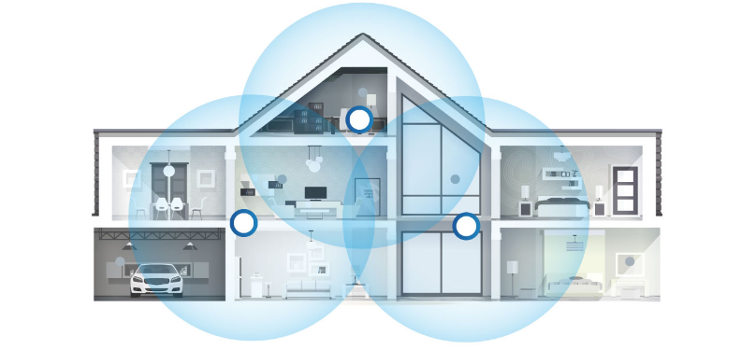
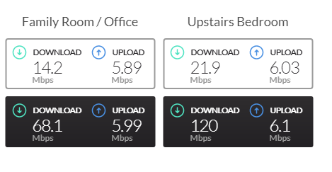
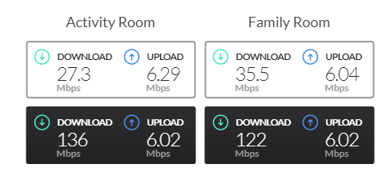
Mesh Network (Router + 2 Nodes)
Speedtest shows the Mbps performance – Down / Up

Slide 10
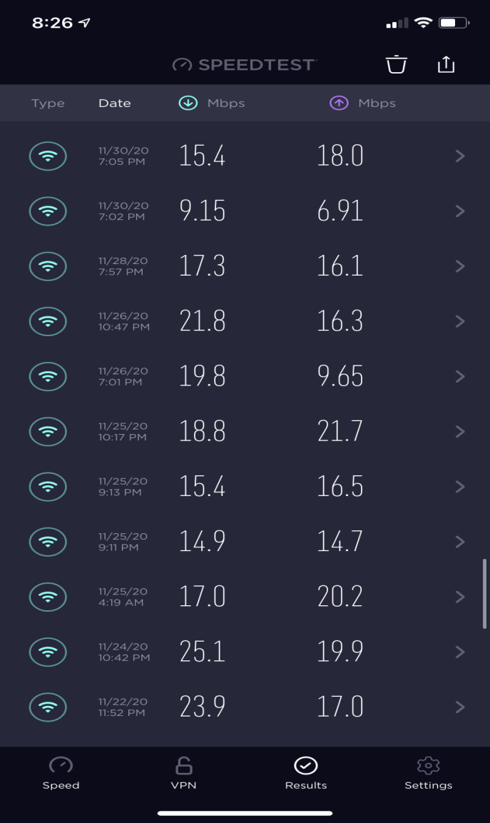
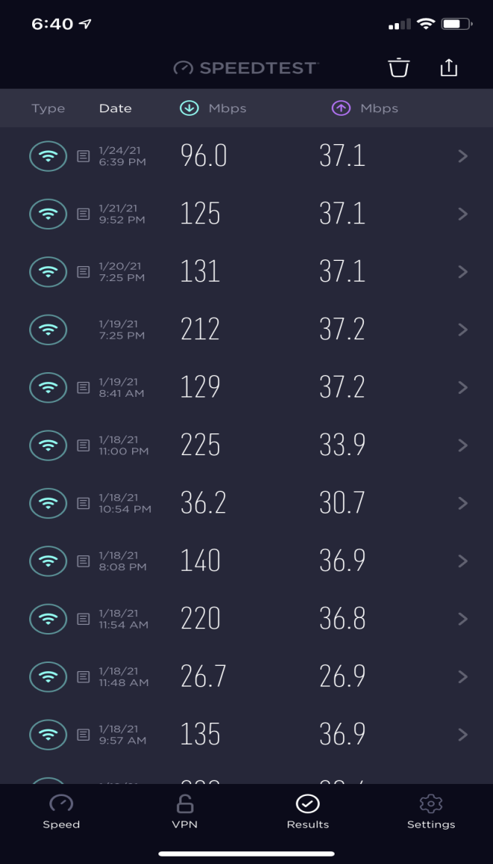
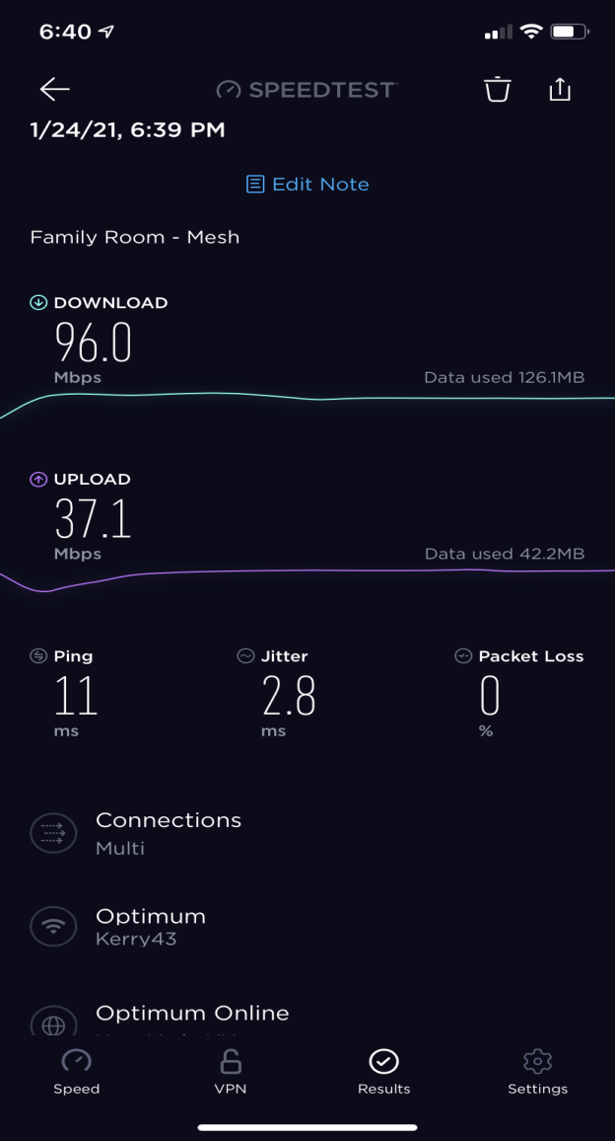
Home Wi-Fi Assessment & Upgrade
Speedtest
What can you learn / what did I learn?
Original Router – Very Poor Fam. Rm
TP-Link / Better –Erratic F.Rm
Mesh Router – Excellent Everywhere

Slide 11
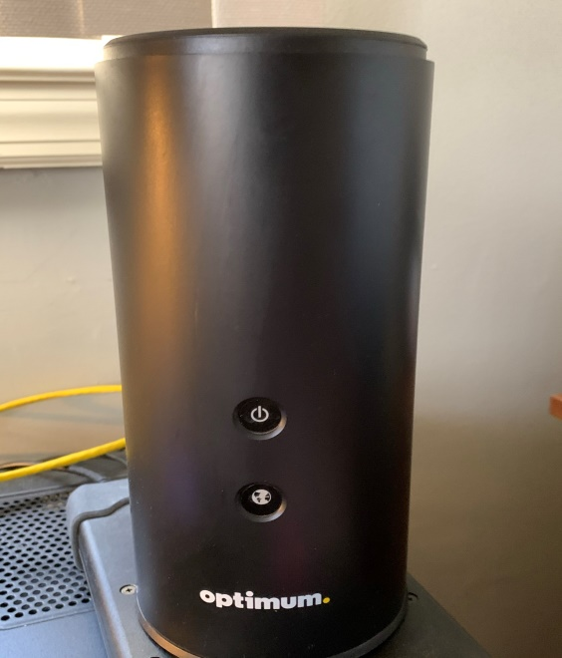
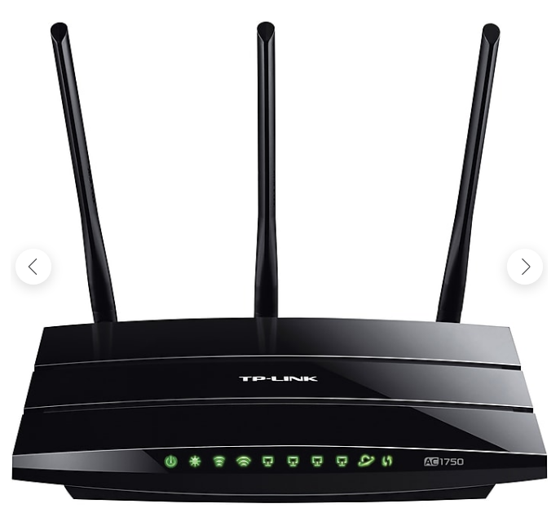
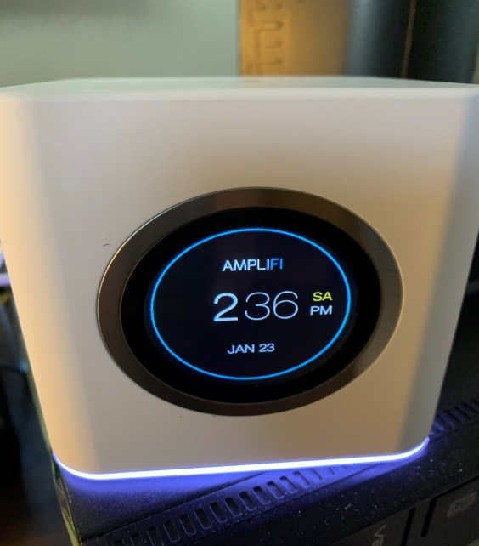
Wi-Fi Router Transition
2012 – 2020 / Optimum
Nov. 2020 / Tp-Link
Jan. 2021 / Amplifi

Slide 12
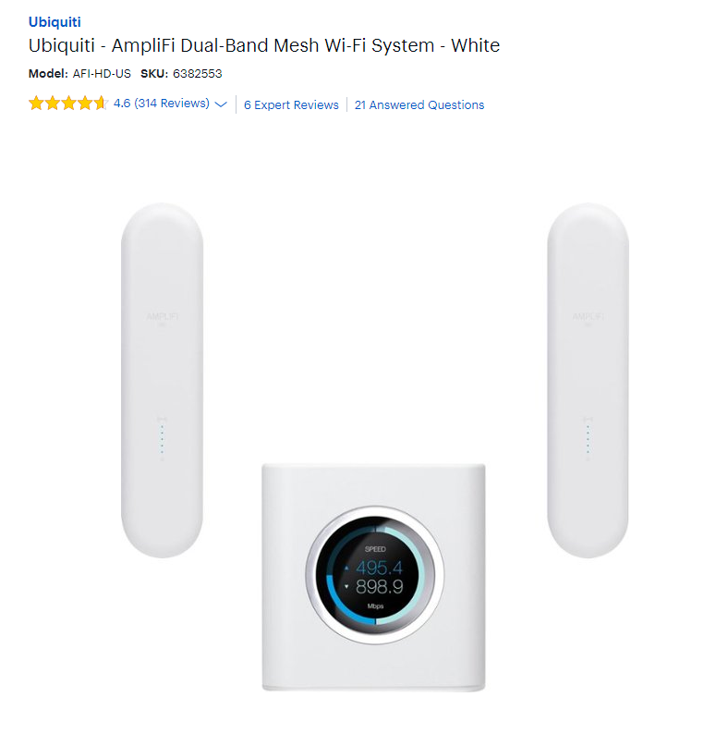
AmpliFi Mesh Wi-Fi System
Best Buy $ 350 (2 Satellite)
My order = $ 284 (router + 1 satellite) @ B&H Photo (NYC) – install Jan18
Prior replace – router + extender = $ 120

Slide 13
Smart TV
PC Club – introduced topic / products and solutions
Resulted in learning a bit but not understanding!
What really is streaming?
Why does my TV need Blue Tooth or wireless support?
How do I get help / what does it cost / look like?
Who can I find to help me?
How would I learn that my internet Wi-Fi is the most important communication resource!
Why – it connects everything in my home!
Introduced to Fire Stick / Net Flex / Disney + (Mandalorian)
Family Facetime calls without static / screen freeze / lost signal

Slide 14
Conclusions
Wi-Fi Signal Strength is a high priority in the present & more important in the future
Video & audio communications is a growing standard
Equipment synergy & compatibility
Create a replacement & education strategy

Slide 15
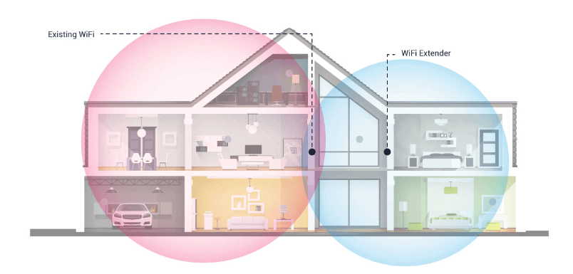
WiFi Extender vs Mesh Network
WiFi Extender – single unit to broadcast existing signal to area with little to no signal
- They are “add-on” to existing network
Mesh system – replaces your network including router with nodes or satellites. Your wireless device connects to closest node. Can be managed via smart phone / create guest network
+ Whole –home coverage
+ Seamless connection / goodbye deadspots
+ Aesthetic design / easy to add nodes
+ Achieve your internet connection $/ Mbps
- Pricier than extenders

Slide 16
The Past
Stability in home technology utilization
Modest growth in leisure / entertainment
Replace the TV
Buy the desktop / connect with Internet
Mobile phones (single purpose – call / talk)
Laptops (start of data mobility)
Long usage life / slow pace of upgrade

Slide 17
How to “See” the problem?
Office (Location of modem/router)
Speed target ( 200 Mbps Down/ 25 Up)
Speed results – Oct/Nov (old router / extender)
Mbps (Down) 48 / 110 / 180 / 143 / 5
Speed results – Nov/Jan (new router/extender)
Office Mbps (Down) 9 / 225 / 190 / 12 / 5 / 2
Extender (Down) 43 / 16 / 23 / 19 / 10
Speed results – Jan/Mar (Mesh Router)
Office Mbps (Down) 230 /
Family Rm (Down) 135 / 131 / 96
Kitchen / Upstair BR (Down) 159 / 207
Dining Room – Zero Screen freeze on Facetime calls

Slide 18
The Present & Future
Product replacement strategy (do you have one?)
What is it ? (my investment was old / outdated)
Do I need it? (Multiple devices - require new tech support)
What’s the benefit
Accomplish tasks in new way
Communicate on the go
Migrating choices – phone / internet / cell
Integrated into most routine tasks / activities
How do I keep up / do I need to ?
Some items to evaluate / How to adjust
Change during past 12-15 months
Do you communicate differently now?
Is Zoom / Facetime familiar experiences?
Have you had a video medical experience? (home support)
Do you sit in a car waiting for access to the doctor? (mobile support)

